Slide 2
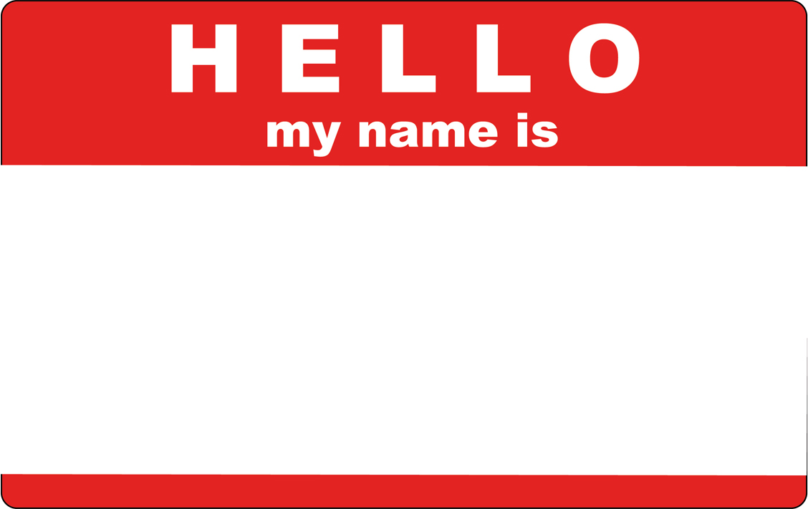
Dan
MacLean
Notes:
I like to introduce myself
My name is Dan

Slide 3
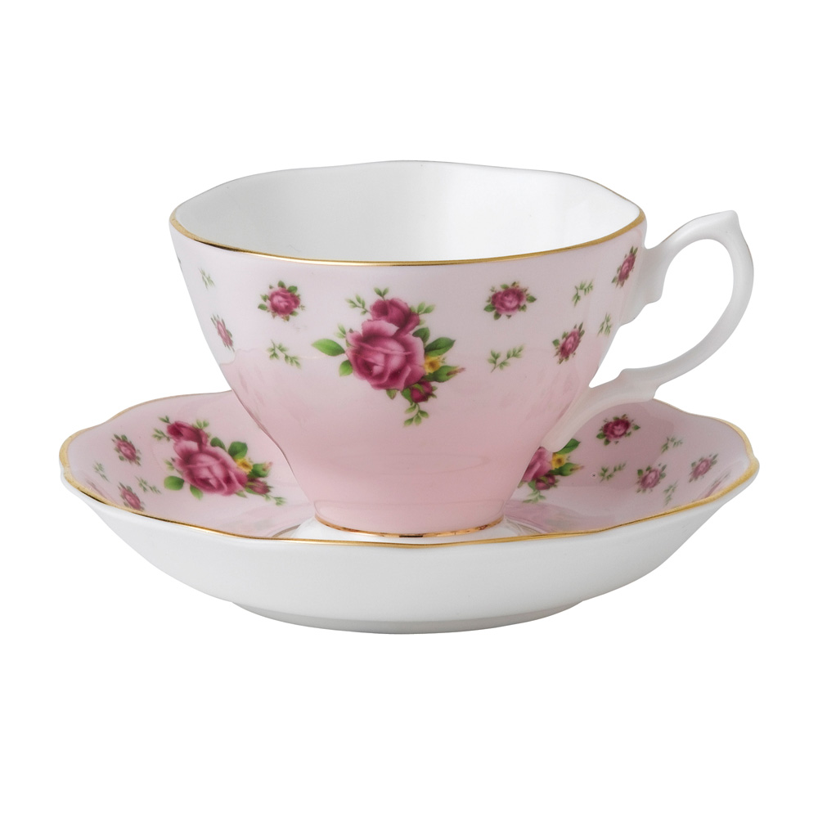
Notes:
And Im from England
Now those of you paying attention might have noticed the noise coming out of my mouth isn’t exactly the same as the one you might be familiar with from films and TV

Slide 4

Notes:
That’s because Im not this sort of Englishman, Im not the stereotypical sort

Slide 5
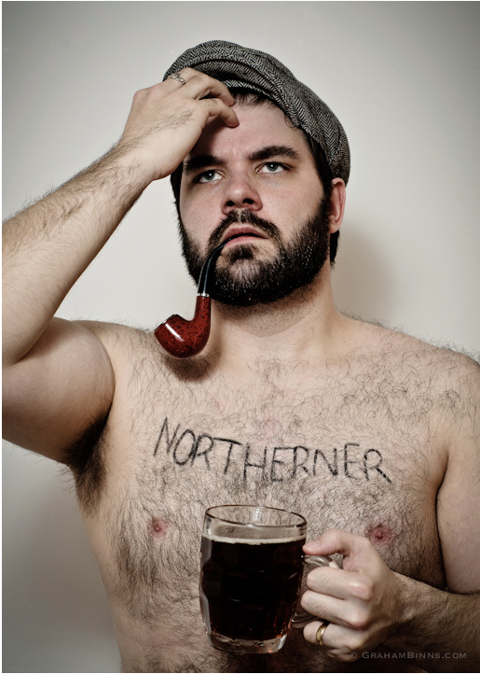
Notes:
Im much more this sort of englishman. Im from the North of England, Im from Manchester, in fact. You may have heard of some of our primary exports, like over rated football teams.

Slide 6
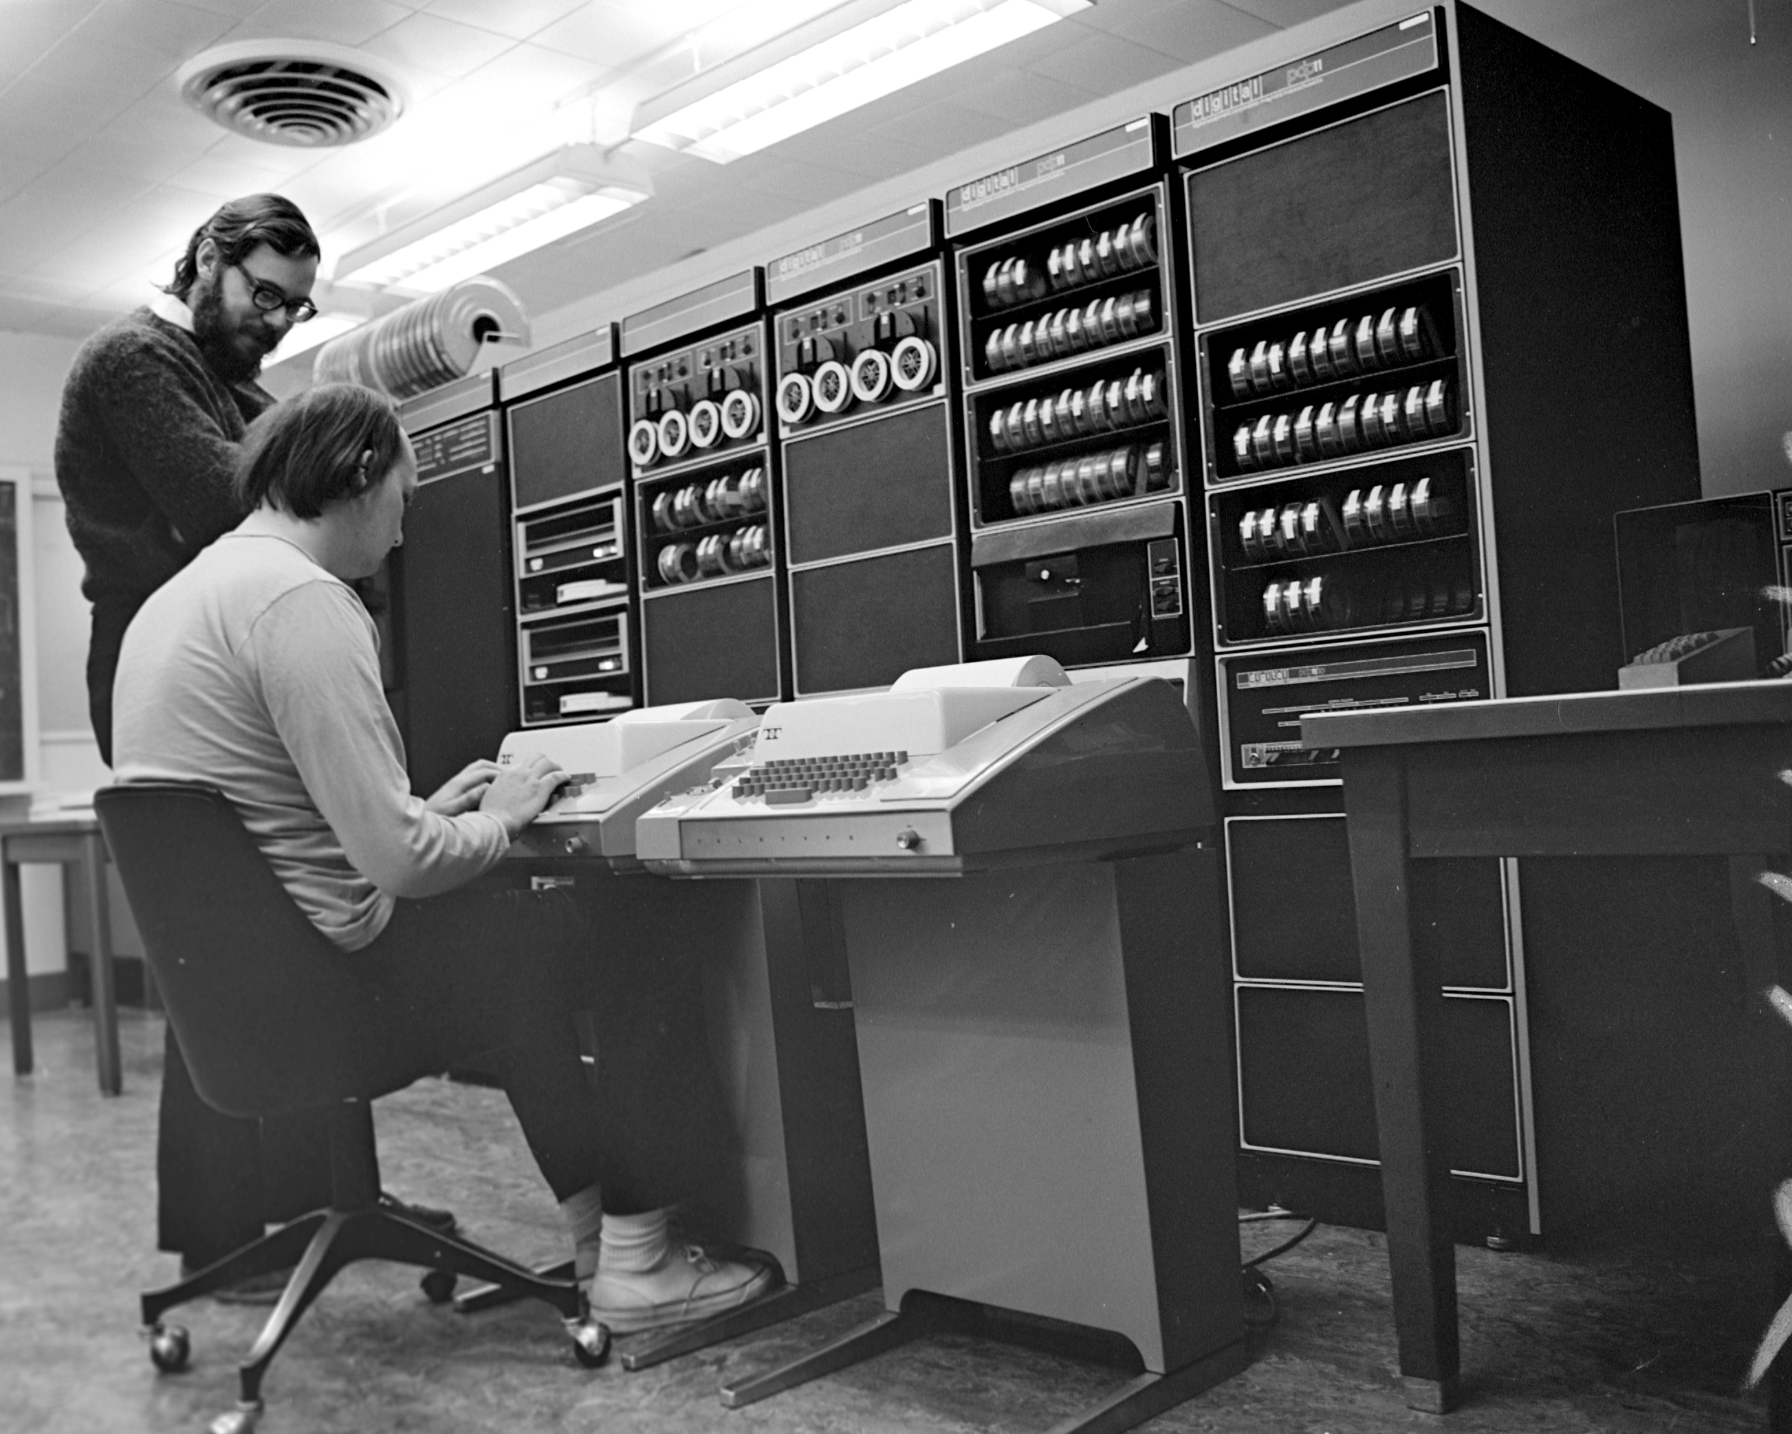
Notes:
Im head of bionformatics at the Sainsbury Lab, in Norwich in the East of England, and we study plant microbe interactions.

Slide 7
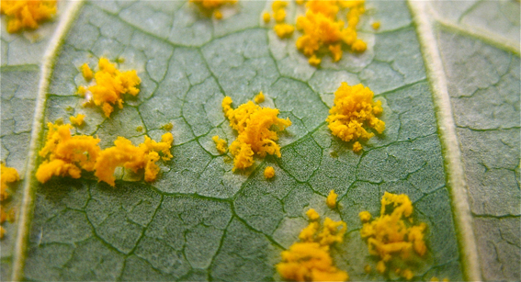
From the ground up
New genomics tools for small communities working with emergent pathogens and non-models
Notes:
Our research focus is to bridge the technology and knowledge gap between big industrial level science like genomics and the labs where the expertise is concentrated. We want to help put the bio back in bioinformatics.

Slide 8
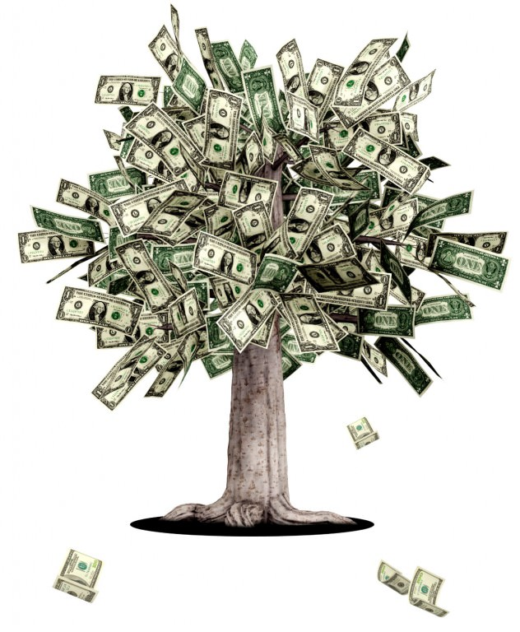
How do you start a genomics project quickly or without a great big grant?
Notes:
So the first big question we’re looking at in our group – How do you kick off a new project without front loaded funding – How do you get the genomics resource for a brand new pathogen no-one has any knowledge about?

Slide 9


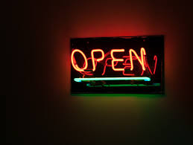
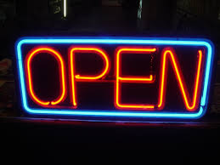


Notes:
One way is to take a cue from the open source software world and ideas from open access databases.
This is a world where every piece of information remains available to anyone at any time, and the people contributing or using feel an intrinsic value in contributing to the over-all goals of the project.
And this isn’t a model we really have in science - normally we have to wait for funding of relatively isolated groups on specific projects and then,
because we are relying on high profile publications to get further funding we sit on results which makes the cycle worse.
and release data only when we’ve finished our own analyses and are ready to publish.
We can kickstart knowledge by making whatever data we can generate and can find instantly available, even before it is analysed, and let whoever can help, do what they can
The practical upshot of this is valuable data gets to many more people who can deal with it much more quickly and more is learned quickly.
We got a great chance to apply this sharing principle for emergent pathogens a couple of years ago

Slide 10
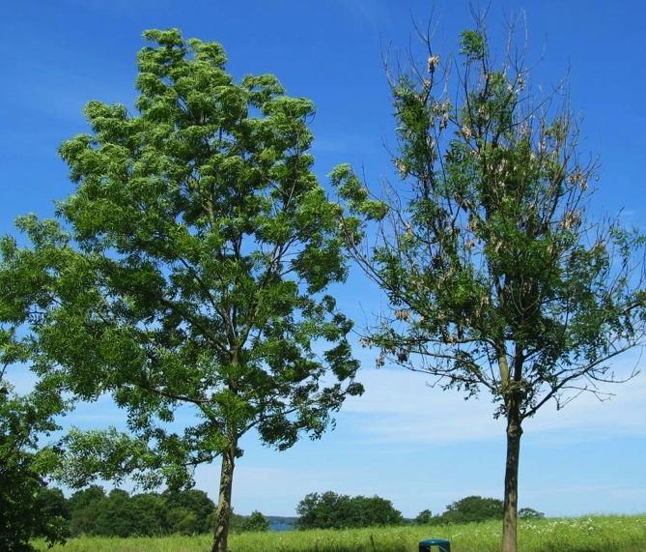
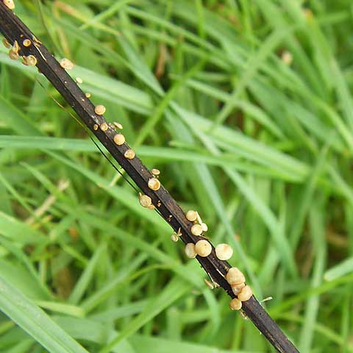
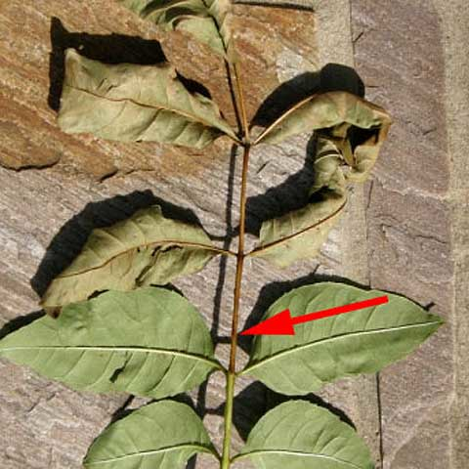
Ash / Fresno (Fraxinus excelsior)
Notes:
… when the ash dieback pathogen reached the uk.
Ash, or Fraxinus excelsior, is an important tree and has been so throughout history.
Ecologically Ash is vital, it’s a fast growing tree that crops up quickly in gaps in woodland and can support a massive range of biodiversity, there are ash woods in norfolk dating back to the time of the vikings
This is what ash dieback looks like
Two roadside trees, The left tree is still looking unaffected this year whereas the right tree is now severely affected and the disease is even starting to affect the growth and the size of it’s crown.
Ash dieback is clearly noticeable as lesions and cankers on stems and branches, these are visible throughout year. Throughout summer you can also see leaves with brown leaf stalks.
Its arrival in England in 2012 caused a fuss in the media and we realised we needed a way to respond quickly and kickstart the research.

Slide 11
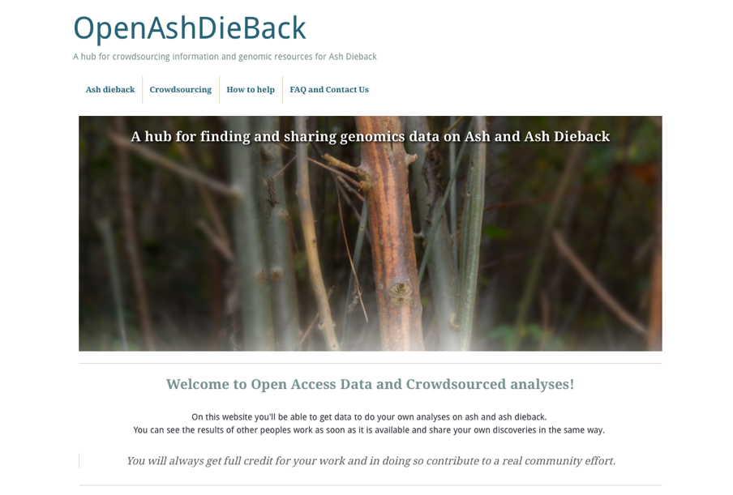
http://oadb.tsl.ac.uk
Notes:
So we applied Open Source and Open Access data principles to try and fast-forward collaboration on genomics of ash and ash dieback.
We’ve put up a hub website to facilitate this, called OpenAshDieBack. Which is at this URL. This website contains links to our data repo and blog posts describing the analyses and data that people have contributed

Slide 12
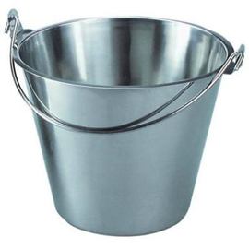


ATTRIBUTION OF CONTRIBUTION
Git and GitHub as a versioned database
push
back
pull
data
make change
Notes:
The data and results themselves are actually hosted externally on the public website, github.
If you’re not familiar with github, it’s a peculiar sort of social networking site
Github is a programmers social coding website. Github is really great at tracking changes to files and keeping records of who made these changes.
The work cycle is really straightforward: you start the day by pulling the latest version of the data from github,
you make the changes/additions/new data that you think are appropriate and push it back.
Github sits in the middle keeping track of what changes were made and who made them.
That’s the key reason for using github, because its critical that we make proper attribution of contribution.
If we’re going to get people to give their time and effort for free, we really need to make sure that we’re giving credit for it.

Slide 13
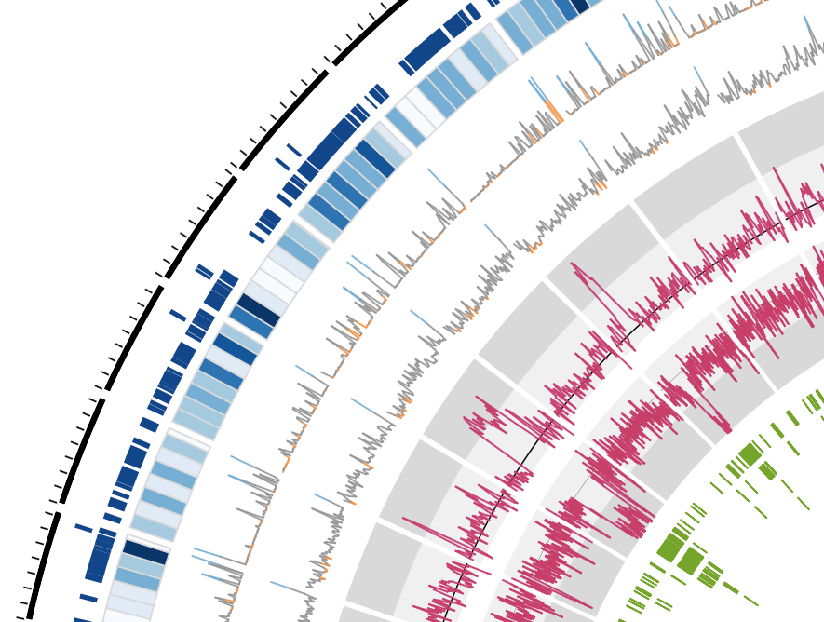
CROWDSOURCING GETS RESULTS
A repeat-rich genome
http://dx.doi.org/10.6084/m9.figshare.791640
Notes:
The analyses are going well,
We’ve been able to push quite far through crowdsourcing analyses and are starting to build up quite a good story about our pathogen.
We had a lot of sequence data provided, of great use was some early RNAseq interaction transcriptomes sampled directly from the tree that identified potential mating loci and types and and potential toxins like NLPs.
TGAC in Norwich provided us with DNA sequence and a first draft assembly, which is what we see here, that gave us insight into effector repertoires and potential toxins like NLPs.
We also got analyses of variation and annotations from these datasets.
In total we had 38 separate analyses, listing hundreds of datasets from diverse sources as well as millions of lines of data. We built a great genomics resource for this new organism.

Slide 14
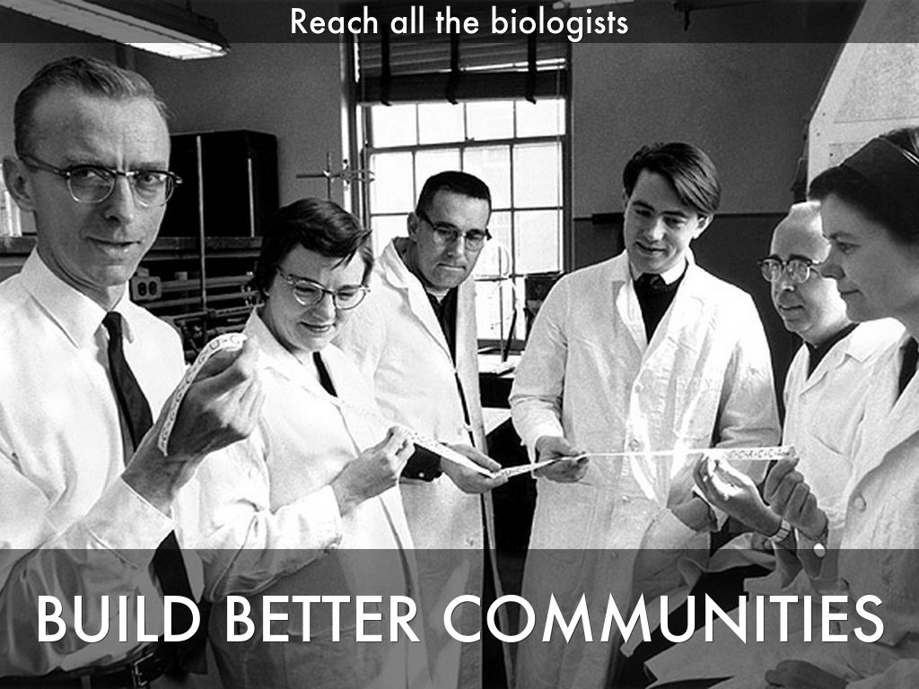
Photo by mars_discovery_district - Creative Commons Attribution-NonCommercial-ShareAlike License http://www.flickr.com/photos/17016583@N00
Created with Haiku Deck
Notes:
We realised that to really add value to our data then the important thing is to bring in as many biologists and not just genomicists, to get involved and liberate the genomics data and expertise to them and get the insights back from them.

Slide 15
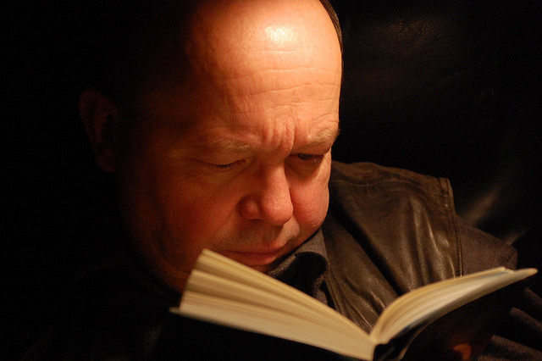
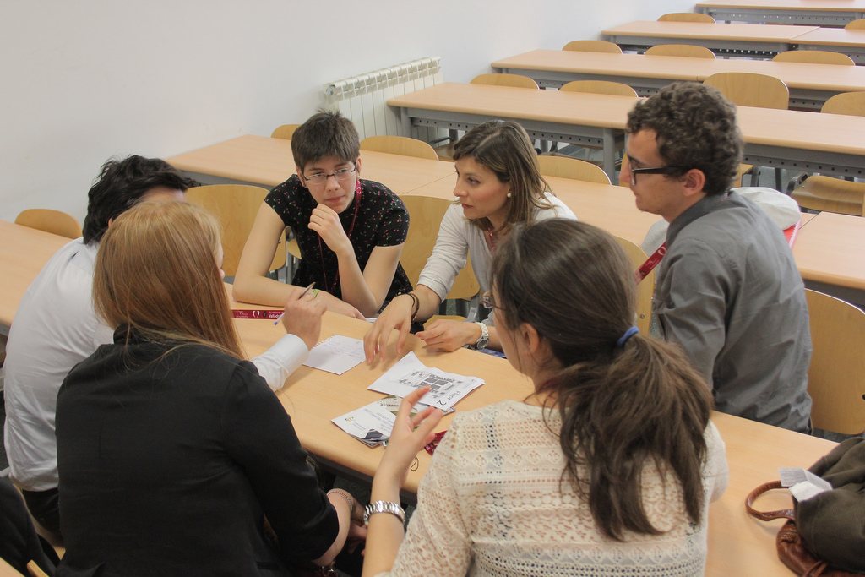
Genomics – a group activity
Reading by JanH on flickr, licensed under CC-BY-NC-SA 2.0
Discussion by Bestorg on flickr, licensed under CC-BY-NC 2.0
Notes:
And we’re trying this through new tools and interfaces.
We’ve put together something we’re calling a crowdsourcing genome-browser. Im sure that you’re familiar with the idea of a genome browser.
Our crowdsourcing browser relates to that in the same way that this guy reading his book relates to these people having a discussion. Our new crowdsourcing browser allows us to take in things like annotations, and experimental information straight into the repository. The info is recorded piecemeal and reflected back to the other users of the tool directly.

Slide 16
GeeFu
Open Source Distributed Genome Annotator and Browser
Notes:
The tool is called GeeFu and it is a graphical tool available over the web, you can annotate and edit genes and transcripts and whole genomes just by clicking and typing.

Slide 17

GeeFu
Open Source Distributed Genome Annotator and Browser
Feature Editor
You have earned the ‘Feature Editor’ badge, Click here to collect it
Notes:
GeeFu can also be set up to dispense rewards for doing work. Completing different numbers of tasks awards the user a badge that can be used to show their expertise. This is particularly helpful for junior researchers and encourages them to add a little knowledge at a time and gain something that differentiates their CVs from others.

Slide 18
GeeFu – in browser analysis
Notes:
GeeFu also provides analysis tools like sequence searches of the provided data too, and fully cross links this back to the annotations and reports Kind of like a “build your own NCBI”, but restricted to a new and growing set of information for the new organism

Slide 19
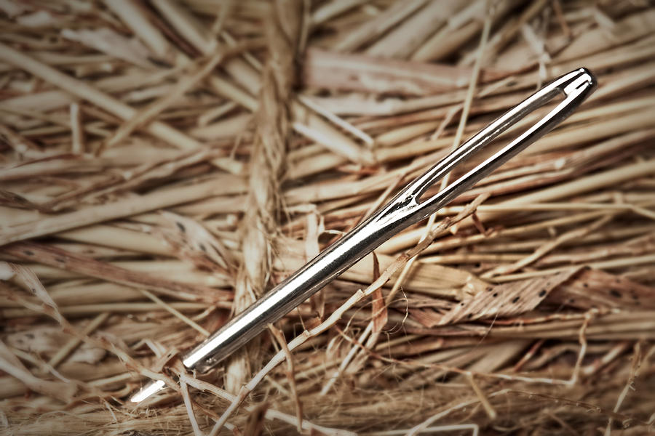
How do you identify causative mutations without a reference genome?
Notes:
So the next question we focus on, is how do we find the variation that causes useful or interesting traits in a new species. Of course modern genomics approaches have lots of ways of doing this, but they have an absolute dependency on a reference sequence. Building one of those is expensive and time consuming.

Slide 20
SNPs are “bubbles” in an assembly
CGA
T
GAT
ATT
TTC
TCT
CTA
TAA
AAG
AGT
2
2
T
2
C
1
T
1
A
1
A
2
G
2
T
2
G
A
TTG
T
TGT
A
GTA
1
1
1
CGATTCTAAGT
CGATTGTAAGT
Notes:
You don’t need a reference to find the SNPs. SNPs represent as bubbles in the internal data structures of the genome assembly software, they cause splits in the assembly path. We can use these bubbles. And by adding an id like colour to the reads then we can mix samples and determine whether a SNP is unique or shared between samples .

Slide 21
Which are the real SNPs?
Method for deciding which bubbles are real SNPs
Six bubble/kmer attributes
Richard Leggett et al PLoS ONE 8(3): e60058. doi:10.1371/journal.pone.0060058
Notes:
We have a couple of programs for finding SNPs. One of these, Bubbleparse is great at classifying and identifying trait linked SNPs, it returns long and accurate lists of SNPs grouped by allele frequencies etc. This graph shows its accuracy around 90% over 100 000 identified SNPs in a proof of principle sample from Arabidopsis.

Slide 22
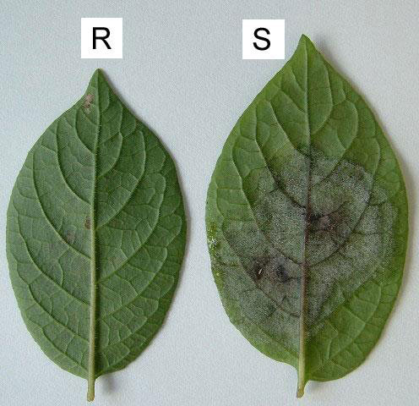
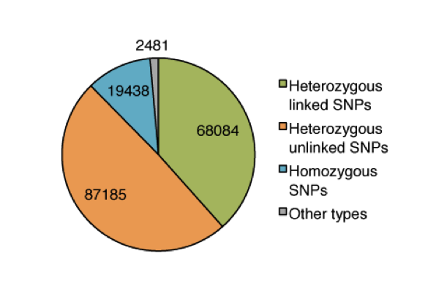
Linked SNPs in wild potato resistant to Phytophthora infestans
Bubbleparse finds trait-linked SNPs
F1 Manually scored for resistance
Sequenced normalised bulk cDNA of 30 R and 30 S
SNPs linked to resistance expected to be 50/50 Het
Solanum berthaultii (R) x Solanum stenotomum (S)
Walter Verweij
Jonathan Jones
Het Linked SNP | Het Unlinked SNP | Total
14/15 | 8/10 | 22/25
Richard Leggett et al PLoS ONE 8(3): e60058. doi:10.1371/journal.pone.0060058
Notes:
And we’ve succesfully applied the system to find thousands of candidate SNPs that may be linked to resistance in wild potato species.

Slide 23
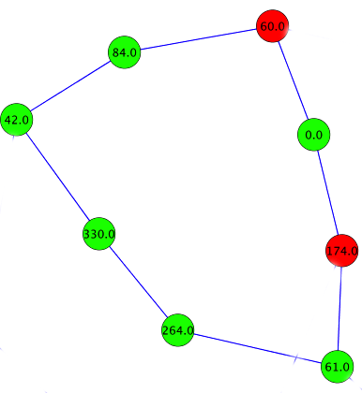
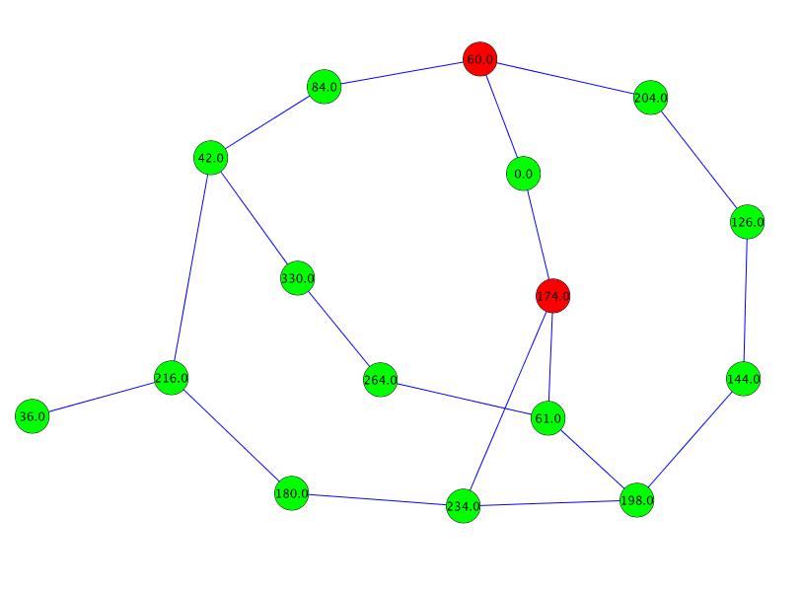
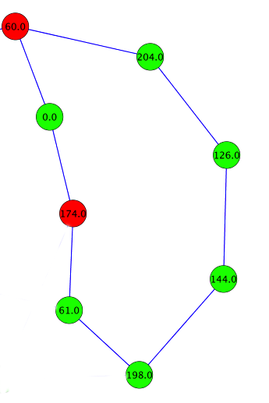
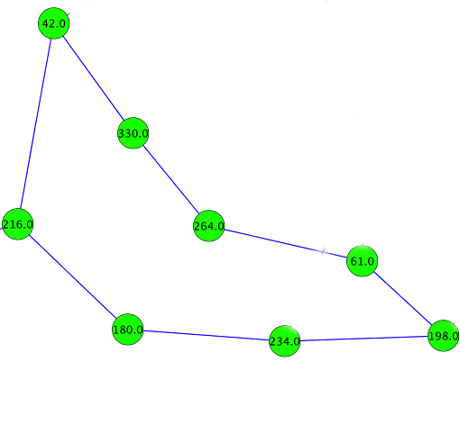
Untangling bubbles with 2k+2
Younsi and MacLean Bioinformatics doi: 10.1093/bioinformatics/btu706
Notes:
In the midst of this we found that the bubbleparse system didn’t find SNPs in regions where the assembly got complicated, like in repeats. So we implemented a system, called 2k+2 that separates our all the tangled bubbles.

Slide 24
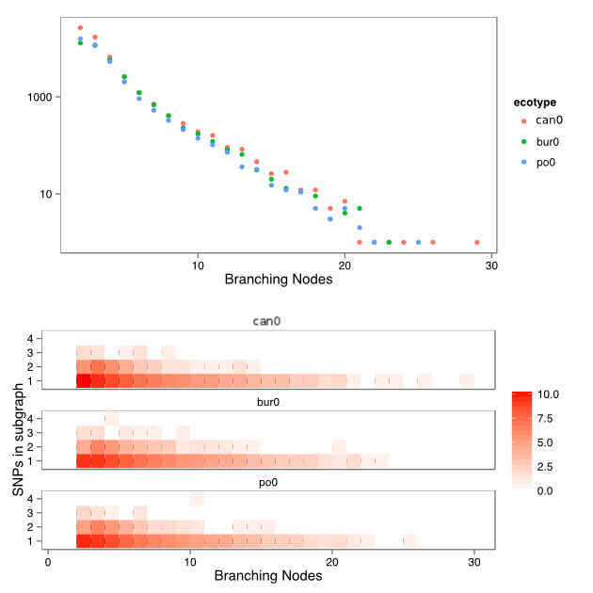
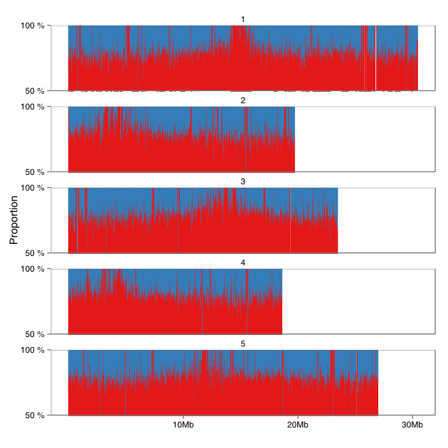
2k+2 sensitive complex bubble detection
TSU1 vs Col0, reads from Schneeberger et al 2011 (1001 genomes)
Blue = 1001 Genomes
Red = 2k+2
Younsi and MacLean Bioinformatics doi: 10.1093/bioinformatics/btu706
Notes:
We ran this algorithm on a range of Arabidopsis ecotypes and it proved to make highly accurate predictions of the SNPs in the tangles (mean of 85%) without the need for other attributes.
Together these programs provide a powerful platform to find SNPs in situations where you lack a reference genome or even where you have a distant reference or a very draft reference they can contribute much to existing pipelines.

Slide 25
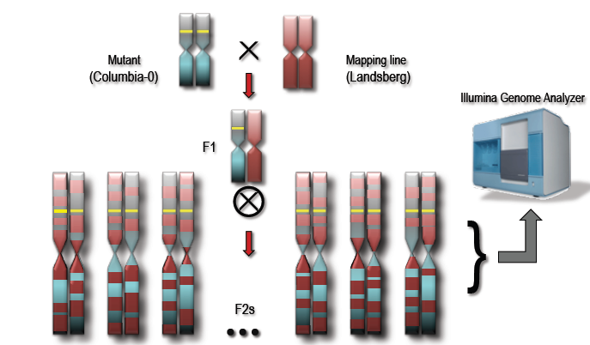
Profiled SNP frequency peaks around mutation after crosses

Slide 26
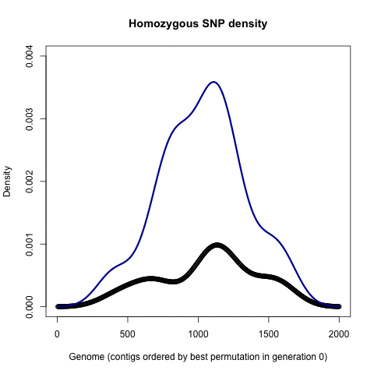
GATROC - optimising contig order for
Unordered contigs
Ordered contigs

Slide 27
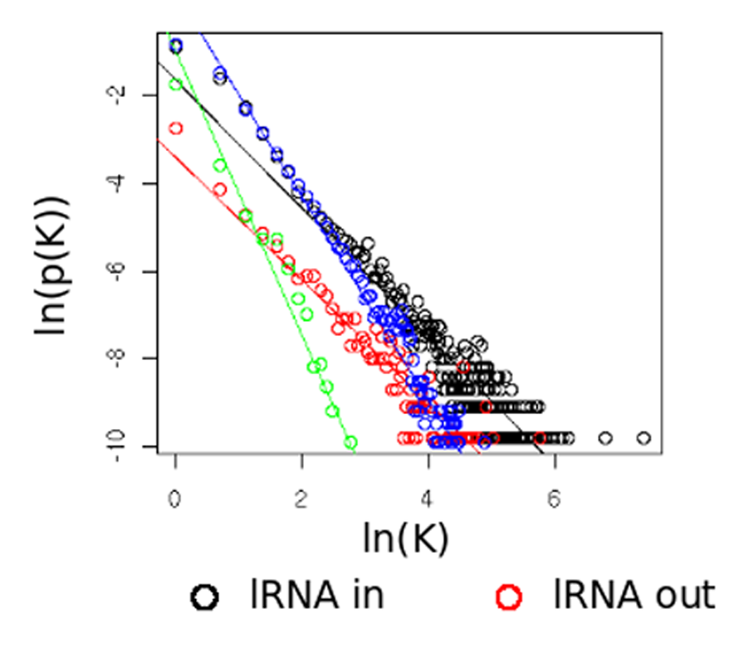
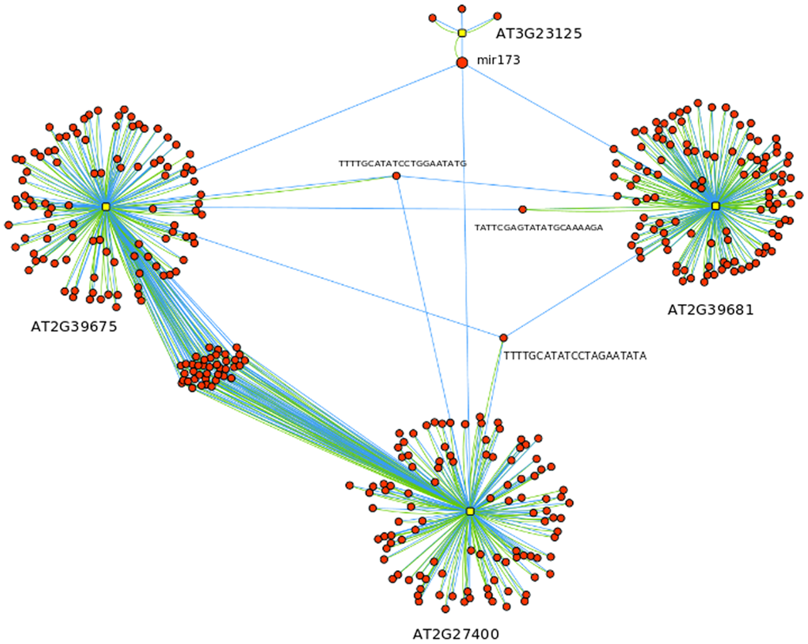
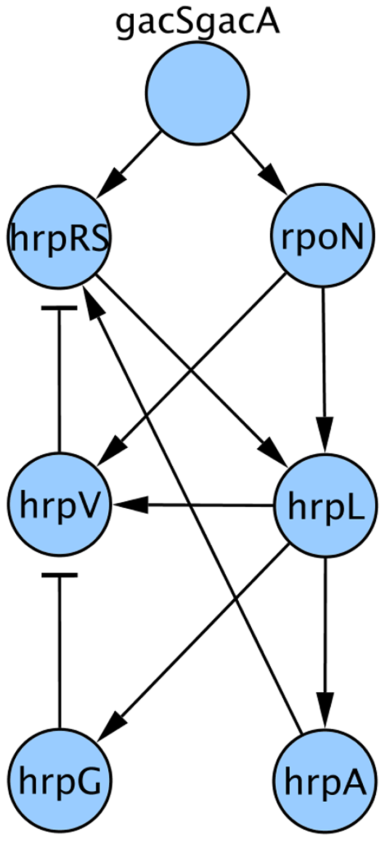
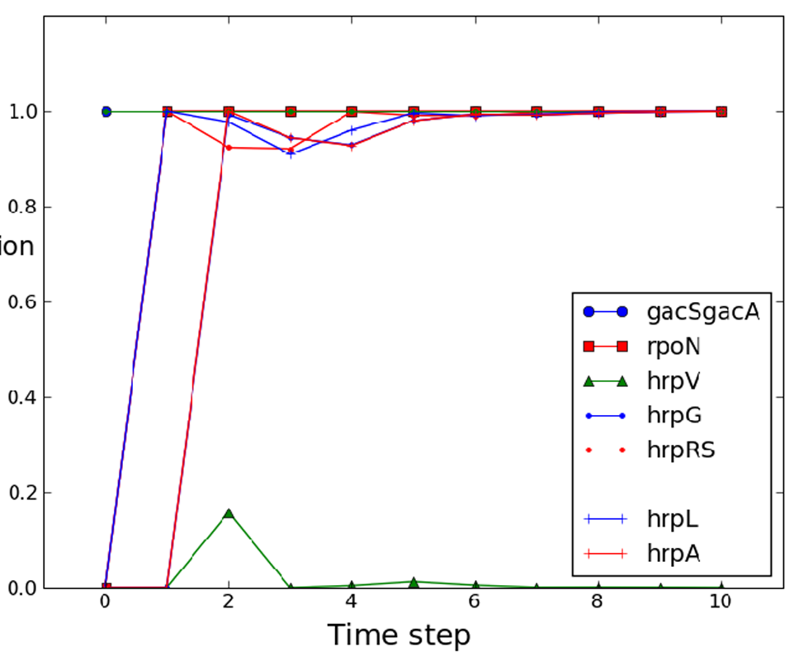
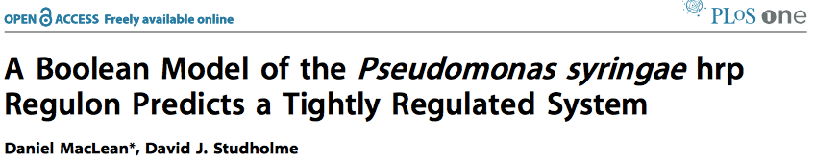
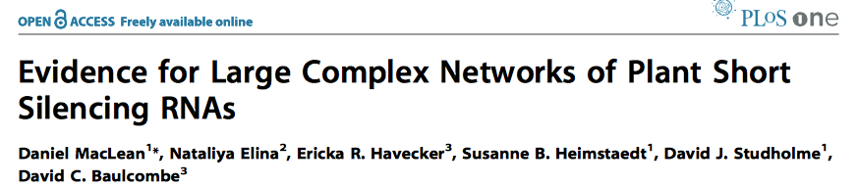
Multidisciplinary focus

Slide 28

How do you bridge the gap between biologist and bioinformatician?

Slide 29
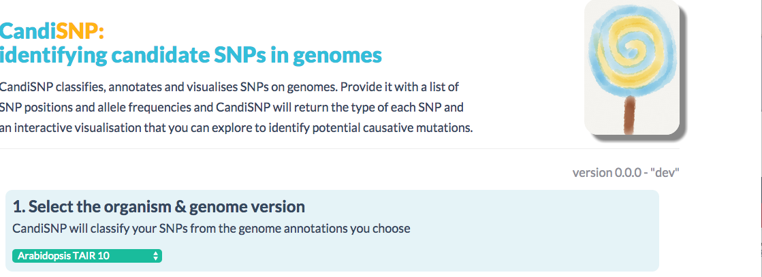
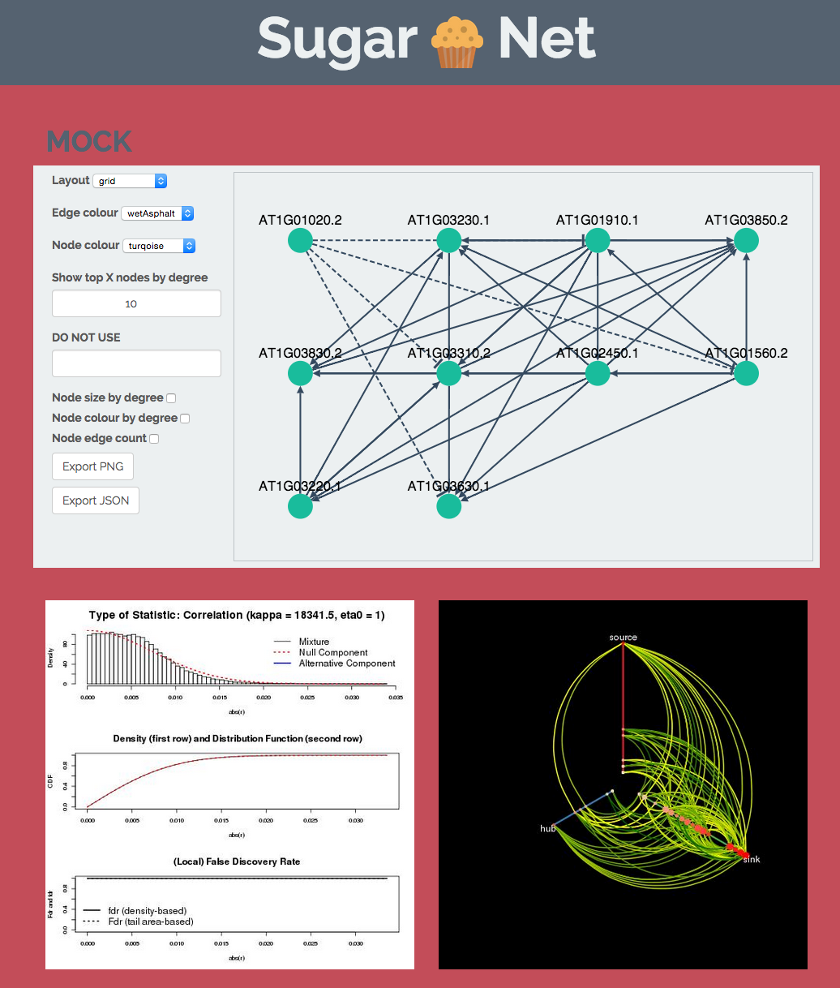
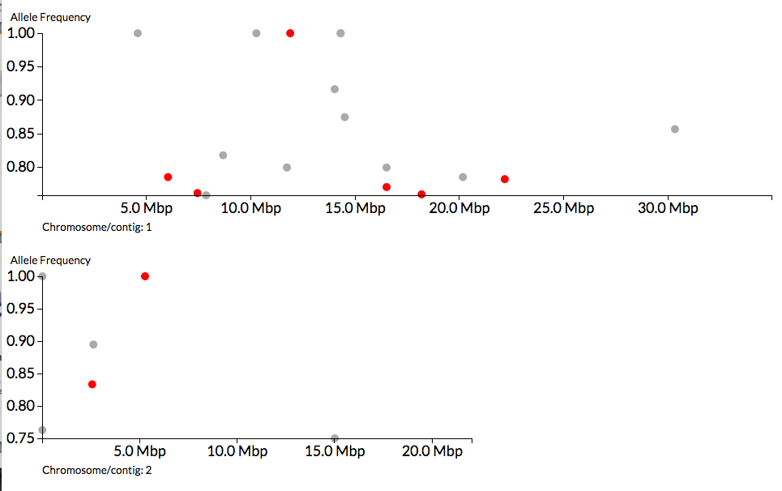
Collaboration

Slide 30
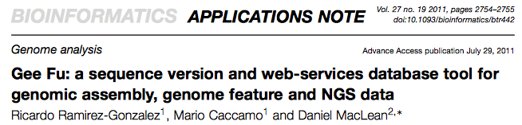
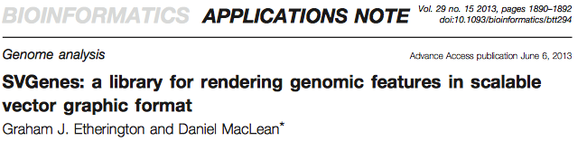

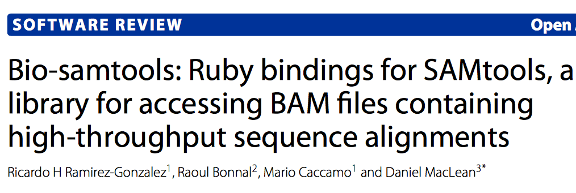
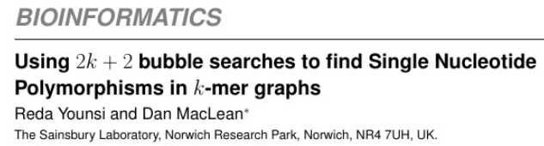
HIGHLY USED SOFTWARE
over 35,000 downloads

Slide 31
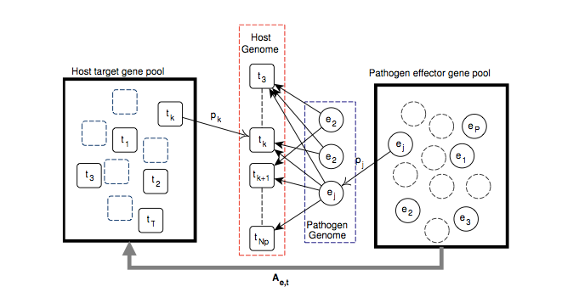

Slide 32
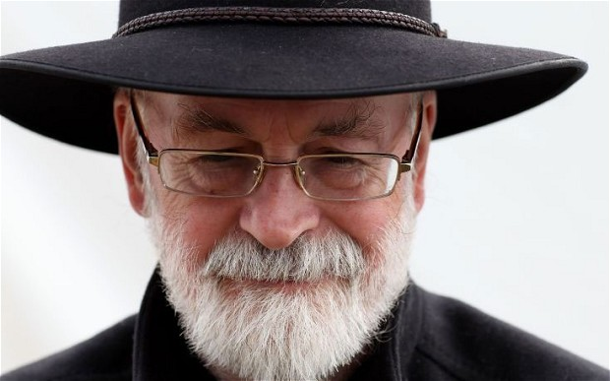
If you build a man a fire, you'll keep him warm for a night. If you set a man on fire, you'll keep him warm for the rest of his life.
— Terry Pratchett
author of Discworld novels
Notes:
So to steal from Terry Pratchett…

Slide 33

ADVERTISEMENT
Notes:
We like galaxy so much, we’ve got really involved. I co-ordinate the UK Galaxy Community and we’re hosting the Galaxy Community Conference at TSL next year. If you are interested in Galaxy either as a biologist who wants to learn it or an informatician who wants to run it this is the best conference.
Around 250 people attend and the first part is all training, the first days are dedicated to workshops run by the galaxy developers themselves.
So please consider yourselves, formerly invited.

Slide 34






Acknowledgements
Martin Page
Graham Etherington
Shyam Rallapalli
Carlos Lugo
Christian Schudoma
Pilar Moreno
Sophien Kamoun
Kentaro Yoshida
Diane Saunders
Suomeng Dong
Joe Win
Cyril Zipfel
Jacqui Monaghan
Reda Younsi
Thomas Down
Allan Downie
Anne Edwards
Mario Caccamo
Bernado Clavijo
David Swarbreck
Manuel Corpas
Ricardo Ramirez-Gonzalez
Notes:
So finally here are just a few acknowledgements, not everyone we’ve worked with at TSL
This is a list of people involved with the work I concentrated on in this talk.

Slide 35

All links in this talk
http://tinyurl.com/dan-maclean

